Slide 1


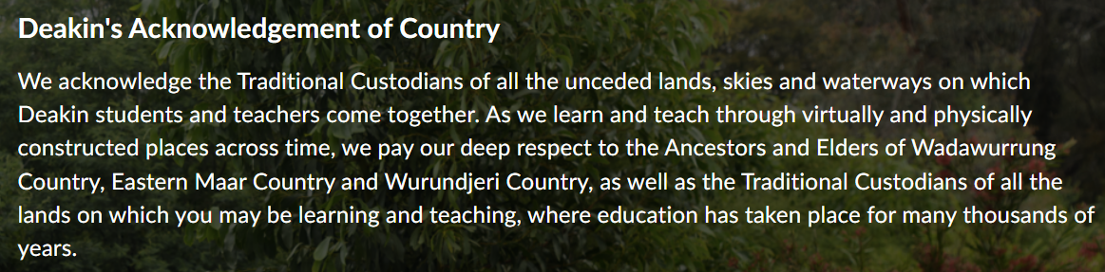
MIS782 Value of Information
Week 11
https://www.youtube.com/watch?v=SF65qrAAEwU&ab_channel=DeakinUniversity

Slide 2
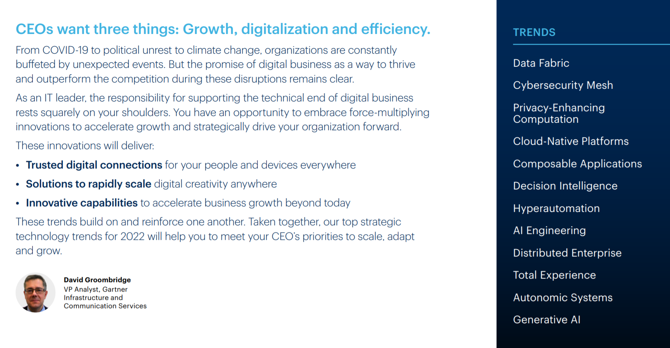
What’s the value of Information in future?
https://www.gartner.com/en/information-technology/insights/top-technology-trends /
Notes:
https://www.gartner.com/en/information-technology/insights/top-technology-trends

Slide 3
Top 10 technology trends: KPMG Global
#1 Hyperscalers: Winners of cloud concentration to dominate software and IT services market
#2 Industry clouds: Tailored platforms become the next big evolution
#3 Quantum computing: Near-term applications promise to optimize complex processes
#4 Metaverse: Business models pivot from physical to virtual real estate
#5 AI: Effective governance and tooling drive adoption at scale
#6 Cybersecurity: Threat actors playing in the gaps and software assurance are top challenges
#7 ESG: Data becomes critical to modeling scenarios and tracking progress
#8 Low-code/no-code: Cultural change needs to follow technological advancements#9 Hybrid working: Choice in the digital workplace drives productivity and well-being #10 Talent: Attracting hot skills demands clear career paths
Notes:
ESG – environmental, social and governance data
https://home.kpmg/xx/en/blogs/home/posts/2022/01/the-top-10-tech-trends-of-2022.html

Slide 4
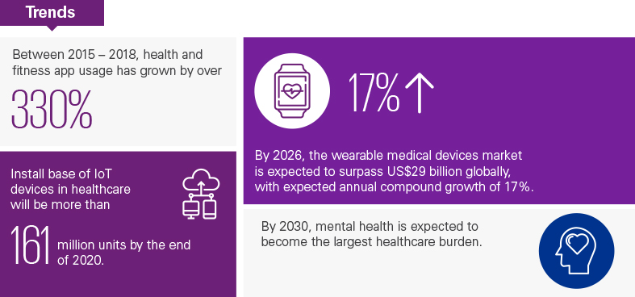
KPMG: 20 Predictions for the Next 20 Years
https://home.kpmg/au/en/home/insights/2020/01/20-predictions-for-the-next-20-years.html

Slide 5
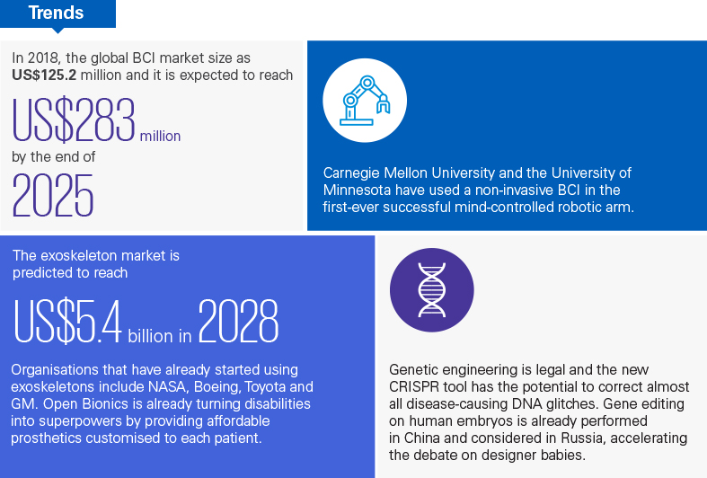
KPMG: 20 Predictions for the Next 20 Years

Slide 6
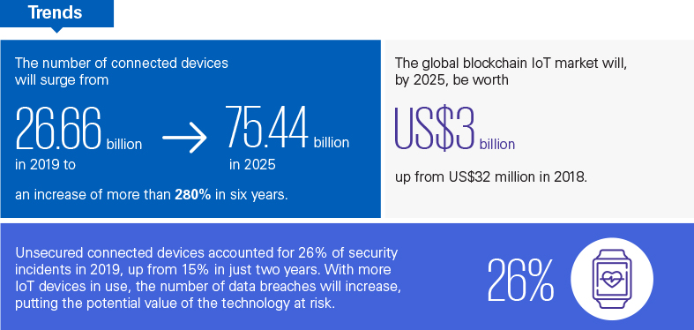
KPMG: 20 Predictions for the Next 20 Years

Slide 7
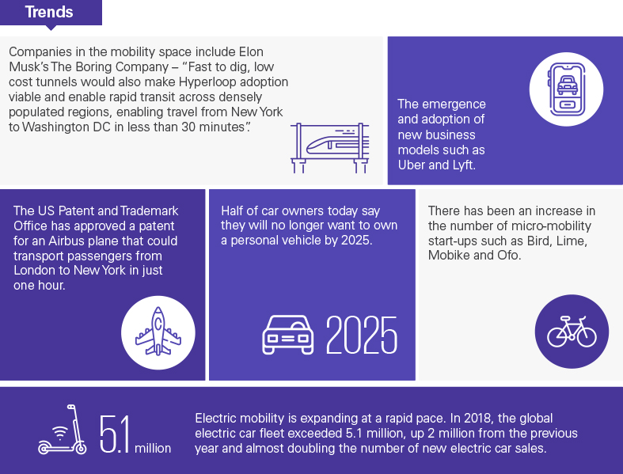
KPMG: 20 Predictions for the Next 20 Years

Slide 8
CEO Views: The technology troubles driving CEO uncertainty
Australia’s top tech entrepreneur and internationally-respected visionary, Adrian Turner, reveals what CIOs should focus on in 2020; and which emerging tech will create new commercial opportunities, when 6 Degrees Media interviewed him for #delltechnologies ‘Connected CIO' video series.
https://www.linkedin.com/posts/angela-horvat-34433a6_delltechnologies-activity-6599472598785110016-bsB6

Slide 9

DCT and technology advances
During Sensing and Seizing, organisations need to understand whether a technology is disruptive or transformative

Slide 10

Generative AI: Disruption or Transformation?
To gain a competitive edge, business leaders first need to understand what generative AI is

Slide 11
What is Generative AI?
Generative AI, which refers to artificial intelligence (AI) algorithms that generate original outputs based on prompt inputs, Unlike previous generations of AI systems, which were primarily designed to recognize patterns and make predictions, Generative AI synthesizes the data it has been trained on and creates content in the form of images, text, audio, video, and more that is similar to content created by human experts – but in much less time, at a fraction of the cost, and with amazing creativity.
According to Boston Group CEO Roadmap:
Generating Content and Ideas. Creating new, unique outputs across a range of modalities, such as a video advertisement or even a new protein with antimicrobial properties.
Improving Efficiency. Accelerating manual or repetitive tasks, such as writing emails, coding, or summarizing large documents.
Personalizing Experiences. Creating content and information tailored to a specific audience, such as chatbots for a personalized customer experiences or targeted advertisements based on patterns in a specific customer's behavior.

Slide 12
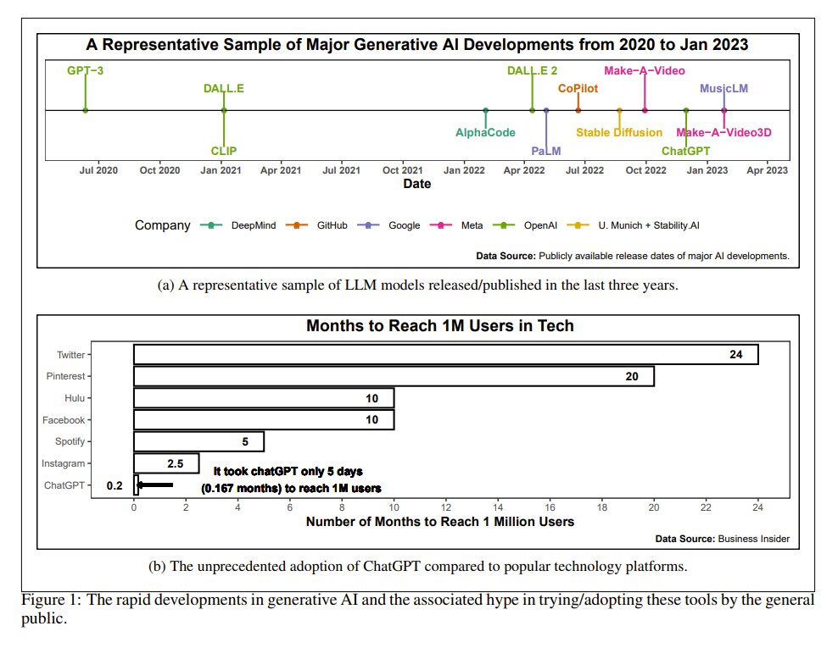
Emergence of AI Generative tools

Slide 13
What Are the Types of Generative AI Models? TYPES OF TEXT MODELS
GPT-3, or Generative Pretrained Transformer 3, is an autoregressive model pre-trained on a large corpus of text to generate high-quality natural language text.
LaMDA, or Language Model for Dialogue Applications, is a pre-trained transformer language model to generate high-quality natural language text, similar to GPT. However, LaMDA was trained on dialogue with the goal of picking up nuances of open-ended conversation.
LLaMA is a smaller natural language processing model compared to GPT-4 and LaMDA, with the goal of being as performant. While also being an autoregressive language model based on transformers, LLaMA is trained on more tokens to improve performance with lower numbers of parameters.

Slide 14
What Are the Types of Generative AI Models? TYPES OF MULTIMODAL MODELS
GPT-4 is the latest release of GPT class of models, a large-scale, multimodal model which can accept image and text inputs and produce text outputs. GPT-4 is a transformer-based model pretrained to predict the next token in a document. The post-training alignment process results in improved performance on measures of factuality and adherence to desired behaviour.
DALL-E is a type of multimodal algorithm that can operate across different data modalities and create novel images or artwork from natural language text input.
Stable Diffusion is a text-to-image model similar to DALL-E, but uses a process called “diffusion” to gradually reduce noise in the image until it matches the text description.
Progen is a multimodal model trained on 280 million protein samples to generate proteins based on desired properties specificized using natural language text input.

Slide 15
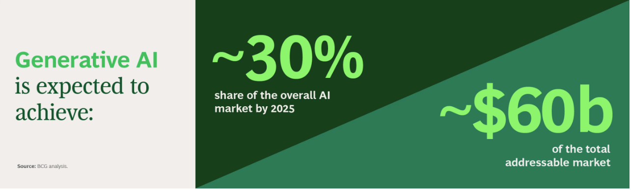
NEED the right use cases, strategy, skills and policies to generate competitive advantage

Slide 16
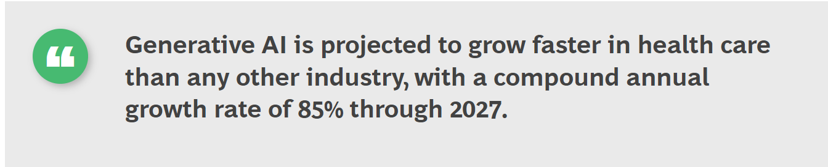

Slide 17
Use Cases For ChatGPT In the Banking Industry
Customer Service - real-time support via chatbot respond to customer queries, complaints, and requests for information quickly and efficiently.
Loan Origination - When customers apply for loans, ChatGPT can provide real-time guidance and support throughout the process.
Wealth Management - personalized wealth management services and customized investment recommendations based on their individual financial goals and risk tolerance
Financial Planning - personalized financial planning services, including budgeting, debt management, and retirement planning.
Customer Onboarding - improving customer onboarding by automating much of the process, reducing wait times, and streamlining the customer experience.
Virtual Assistants for Banking - virtual assistant that is available 24/7 to help with managing their accounts, paying bills, and performing transactions
Notes:
Bernard Marr, FORBESINNOVATIONENTERPRISE TECH, Mar 8, 2023
Top 10 Use Cases For ChatGPT In The Banking Industry
Banks have often been at the forefront of adopting cutting-edge technology to provide better customer service and meet compliance requirements. With the rise of AI, banks can now leverage generative language tools like ChatGPT to improve productivity, streamline operations, and enhance their services. Of the many different ways banks can use ChatGPT, here are some of my favorites:
1. Customer Service
Banks can use ChatGPT to transform their customer service by providing real-time support via chatbot. With ChatGPT's natural language processing (NLP) capabilities, it can respond to customer queries, complaints, and requests for information quickly and efficiently.
2. Fraud Detection
ChatGPT can assist banks with detecting and preventing fraud by analyzing vast amounts of transaction data and identifying suspicious patterns. This can help banks protect customers' financial assets and reduce losses from fraud. Bank personnel can even set up alerts, so security professionals get notified of suspicious activity.
3. Loan Origination
Loan origination is a complex process that involves multiple steps, including collecting customer data, analyzing credit scores, assessing risks, and processing loan applications. By leveraging ChatGPT's natural language processing (NLP) and machine learning (ML) capabilities, banks can automate many of these tasks, making the loan origination process quicker and easier for customers and bank employees alike.
When customers apply for loans, ChatGPT can provide real-time guidance and support throughout the process. Then the model can assist banks in gathering customer data, analyzing creditworthiness, and providing real-time feedback on loan applications. With ChatGPT's ability to analyze vast amounts of data and make accurate predictions, banks can reduce the risk of default and make informed decisions about loan approvals.
4. Wealth Management
ChatGPT can assist banks in providing personalized wealth management services to their customers by analyzing customer data and providing customized investment recommendations based on their individual financial goals and risk tolerance.
5. Compliance
Compliance is a crucial aspect of banking, and non-compliance can lead to significant financial penalties and reputational damage.
ChatGPT can help banks comply with regulatory requirements by monitoring bank transactions and identifying potential compliance violations. This can help banks avoid costly fines and penalties and protect their reputation.
6. Financial Planning
Many customers rely on banks to provide financial planning services, and this is another great opportunity for using ChatGPT. Banks can use the model to provide personalized financial planning services, including budgeting, debt management, and retirement planning.
7. KYC and AML
Know Your Customer (KYC) and Anti-Money Laundering (AML) processes are critical for banks to mitigate financial crime risks and maintain regulatory compliance.
ChatGPT can assist banks in automating these processes by analyzing large amounts of customer data, including personal information and transaction history, and identifying potential compliance issues. It can also verify customer identity, check customers against sanction lists and flag suspicious transactions. This reduces the risk of errors and improves the accuracy of compliance checks.
8. Customer Onboarding
Customer onboarding is a critical process for banks to attract and retain customers, but it can be time-consuming and complex. ChatGPT can assist banks in improving customer onboarding by automating much of the process, reducing wait times, and streamlining the customer experience.
ChatGPT can assist customers with:
● Filling out onboarding forms
● Getting answers to their questions about banking rules and processes
● Addressing their concerns about switching banks
● Opening new accounts
The model can also help banks with the following tasks during the onboarding process:
● Checking customer data for accuracy
● Flagging issues that need to be corrected
● Verifying customer identities
● Offering personalized onboarding experiences for customers
● Addressing customer concerns
9. Risk Management
ChatGPT can assist banks in identifying and managing potential risks by analyzing vast amounts of data and identifying potential risk factors. Banks can also use ChatGPT to monitor transaction activities, flag suspicious transactions, and identify potential fraud.
The model can also analyze market data and news to assess potential economic and political risks that may impact the bank's operations. With ChatGPT's machine learning capabilities, banks can continually learn from past risks and improve risk management processes over time.
10. Virtual Assistants for Banking
Banks can provide their customers with a virtual assistant that is available 24/7 to help with managing their accounts, paying bills, and performing transactions.

Slide 18
Education and Generative AI
Specificity and relevant information provided by ChatGPT on diverse disciplines (e.g. science, history, business, health, technology, etc.) or are useful
lessen the instructional workload of teachers and provide students with immediate feedback.
Cheating and getting away with it
challenges with the accuracy of responses, the provision of alternative answers or responses which at times contradict previous answers provided on the same topic, and its limited ability to provide certain contextual information/sources.
Fairness of the provided learning content
Appropriateness and naivety of the created learning assessments
Unlocking the full potential of learning assistance
Honesty and truthfulness of ChatGPT
Absence of emotions or reflections on students’ engagements
Tlili (2023). What if the devil is my guardian angel: ChatGPT as a case study of using chatbots in education. Smart Learning Environments, 10:15 https://doi.org/10.1186/s40561-023-00237-x

Slide 19
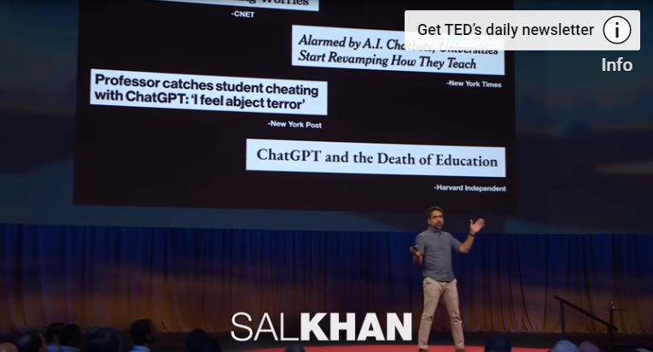
A Personal tutor for every child on earth?
The Amazing AI Super Tutor for Students and Teachers | Sal Khan | TED - Bing video

Slide 20
Real consequences of Generative AI
There are also concerns that Generative AI will lead to job displacement, as the technology becomes capable of performing tasks that were previously done by humans.
Large scale automated faking might be particularly dangerous since it would spread adverse impact beyond what a few bad actors would likely do.
a real possibility of a descent into mediocrity as fakes fed on themselves in a “never ending resounding echo chamber of cyber-generated nonsense.”
Risk of a loss of “art,” both in the creation of and the appreciation of content, with creatives having significantly reduced value. “boring as hell”.
Privacy laws might require revisions as policymakers learn more about how vulnerable groups could be affected by the proliferation of fakes, and in what ways.
Houde et al (2020). Business (mis)Use Cases of Generative AI, IUI ’20 Workshops, Cagliari, Italy

Slide 21
“ChatGPT will always have bias, says OpenAI boss”
- Sam Altman argues the world will never agree on chatbot’s politics

Slide 22
THE ETHICAL ISSUES TIED TO GENERATIVE AI GOVERNANCE
Unknown Capabilities. Large generative AI systems such as ChatGPT have exhibited a massive capability overhang—skills and dangers that are not planned for in the development phase and are generally unknown and unexpected even to the developers. This can pose a serious threat if the right guardrails are not in place to effectively manage unexpected usage.
Bias and Toxicity. Outputs from generative AI will be as biased as the data it is trained on. Many popular language models today are trained on the wilds of the internet, where there is plenty of bias—along with toxic language and ideas.
Data Leakage. Many companies have quickly put policies in place to forbid employees from entering sensitive information into ChatGPT, fearing that it could get incorporated into the AI model and reemerge in public.

Slide 23
THE ETHICAL ISSUES TIED TO GENERATIVE AI GOVERNANCE
Hallucination. ChatGPT can make arguments that sound extremely convincing but are 100% wrong. Developers refer to this as “hallucination,” a potential outcome that limits the reliability of the answers coming from AI models.
Lack of Transparency. Generative AI models currently provide no attribution for the facts underlying the content they generate, which makes it impossible to verify the correctness of generated claims—further increasing the danger posed by AI-model hallucinations.
Copyright Controversies. Since the data sets used by AI models are derived from the public internet, a legal question arises: Does the content those models create amount to duplications of copyrighted works?

Slide 24
Responsible, Safe and Ethical use of Generative AI
Rather than waiting to “see what happens,” we need to be proactive in designing possible future applications that are responsible, safe and ethical.

Slide 25
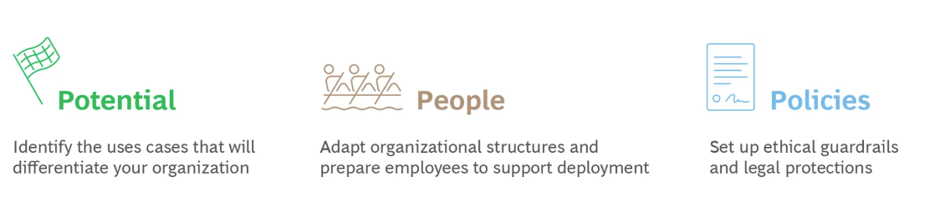
Roadmap for Generative AI in organisations
Business use case briefs/user stories/user scenarios/Design fictions have been applied to the design of new technology, to explore how future users may adopt a technology, and as critical tools to anticipate the social and political consequences of technologies >> Assignment 3 identify the RIGHT USE CASES

Slide 26
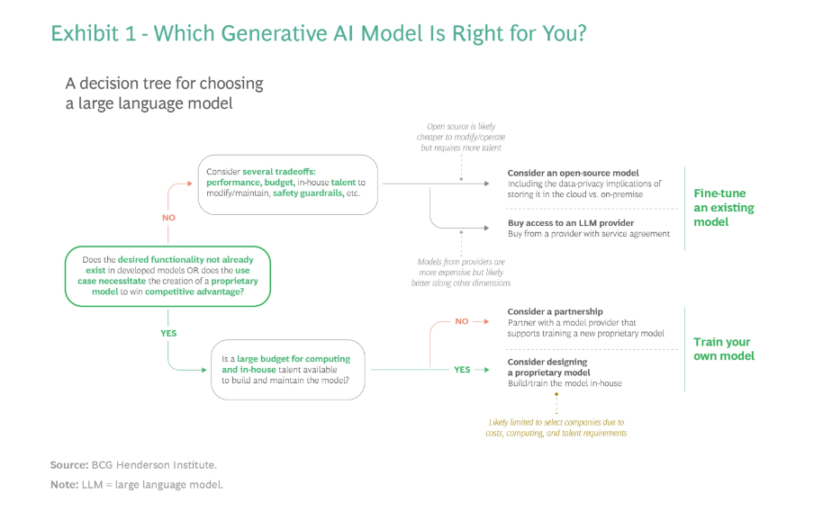
Plan your investment
The CEO’s Guide to the Generative AI Revolution | BCG

Slide 27
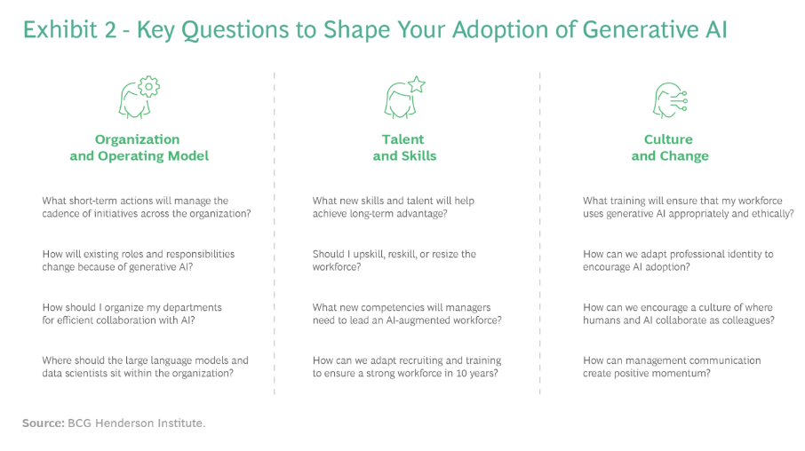
Prepare your workforce
The CEO’s Guide to the Generative AI Revolution | BCG

Slide 28
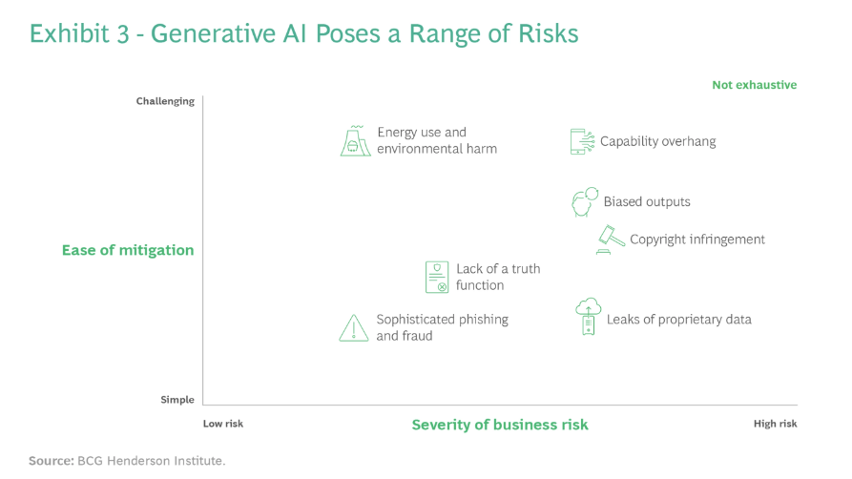
Prepare for Risk
The CEO’s Guide to the Generative AI Revolution | BCG

Slide 29
Seizing and transforming the opportunity with Generative AI
Coming up with ideas is not enough. We need to develop and create opportunities for them to develop to become real business opportunities.
We should pay attention to broader trends and patterns, new business models, digitalization trends and capabilities, and socio-economic trends, to see how we can leverage on these trends for our businesses.
Embrace the technology rather than banning it
Need for new philosophy of work > future of work
Nothing should be taken for granted
Upskilling your competencies
Developing humanized chatbots (lacks thinking or revealing emotions)
Developing responsible chatbots (dishonesty, manipulation, and misinformation)

Slide 30
Disruption or transformation?
Gartner has declared generative AI as one of the most disruptive and rapidly evolving technologies in their 2022 Emerging Technologies and Trends Impact Radar report.
“As a disruptive technology, Generative AI can enable truly innovative services and business models that engage all platform stakeholders in unprecedented ways. Despite this promise as a game changer, the interplay between the Generative AI’s inherent potential and its transformative value for digital platforms is poorly understood and requires further research.”
JMIS_SI_CfP_Generative_AI_2023-03-20.docx (jmis-web.org)

Slide 31
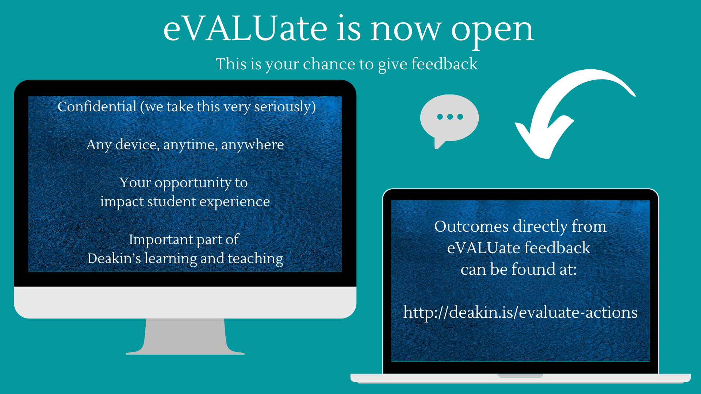


Slide 32
You said, we did: changes made in T1 2023
We have revamped the seminars and embedded additional case study discussions with real life examples to add value to your learning experience
The assessment weightings have been adjusted to reflect workload (30, 40, 30)
Exam has been replaced with end of term assessment
New content on disruptive technology and Generative AI

Slide 33
TELL US WHAT YOU THINK
WE’LL LISTEN
https://deakin.is/evaluating-us

Slide 34

That concludes the MIS782 content
Thank you for being here
Thank you for being a wonderful bunch!!

Slide 35
References
Dwivedi et al. (2023). “So what if ChatGPT wrote it?” Multidisciplinary perspectives on opportunities, challenges, and implications of generative conversational AI for research, practice and policy”, International Journal of Information Management, 71, https://doi.org/10.1016/j.ijinfomgt.2023.102642
Frederick, D. E. (2023). ChatGPT: a viral data-driven disruption in the information environment. Library Hi Tech News. ISSN: 0741-9058
The CEO’s Guide to the Generative AI Revolution | BCG
What is Generative AI and How Does it Impact Businesses? | BCG
10 Generative AI Use Cases That Will Change How You Work (fireflies.ai)
Introduction to Large Language Models - Bing video

Slide 36
ChatGPT is the best free teacher, But most people only leverage 10% of its capability. Here are the best 10 prompts to learn anything faster Via Generative AI
1. Write a compelling copy:
This cheat code will help you write a quality copy with ChatGPT.
Just give the following inputs :
1] Word count
2] Product name
3] Customer painpoint
4] Risk Reversal
5] Call to action
2. Brainstorm any idea
Generate a list of many ideas for your next project in just 5 sec using the following inputs :
1] What
2] Specific things
3] How many ideas do you want
4] Goal
5] What do you want it to do?

Slide 37
3. Break down concepts for easier learning
Prompt: ''Break down [any topic or skill] into smaller, manageable chunks or units, and provide a structured plan for mastering each one.''
4. Travel with ease
Find any restaurant or hotels when you go for travel giving the following inputs:
1] Specific location
2] Type of foo
3] Filter by your choice
5.Create a winning marketing strategy
'' I want you to act like a marketing specialist and develop a marketing campaign for a [product or service]. Use a variety of tactics and channels to reach the target audience and achieve specific objectives. Consider the competition, budget, and target audience when planning the campaign. be sure to track and analyze the results of the campaign and adjust as needed.''

Slide 38
6. Learn anything
ChatGPT will provide you with any of your questions.
You can use it to do your projects, school work, or anything...
You can ask it directly or paste links.
7. Learn to ask better questions
Prompt: "Guide me on how to formulate effective questions related to [topic or skill] that will promote deeper thinking and stimulate curiosity.”
8. Summarize any books
You now have the power to get new ideas from books in just 5 or 8 seconds.
Prompts: Summarize the main points from "Influence" by Robert Cialdini. And pull me some great quotes from it.
Via Generative AI #artificialintelligence

Slide 39
9. Talk with any experts
Ask ChatGPT to become an expert in any field (entrepreneurs, teachers, guide, etc) Note - The prompt "Let's play a game" is really important to enter the conversation.
10. Assist with decision-making
Prompt: ''Help me weigh the pros and cons of [decision or choice], and provide a suggestion based on the analysis.''

Slide 41

You said, we did: changes made in T3 2021
Assignments (aligned with seminars) were re-written with concrete structure to reduce ambiguity and establish expectations
Assignment video presentation was introduced to provide formative feedback. We also believe this has helped groups get organised earlier than later.
We have introduced weekly class and seminar so that students can access and engage in discussion based on problem-based real life example cases.
Exam sample paper updated to reflect the exam format and type of questions. Seminars were redesigned to align better with exam questions.

Slide 42
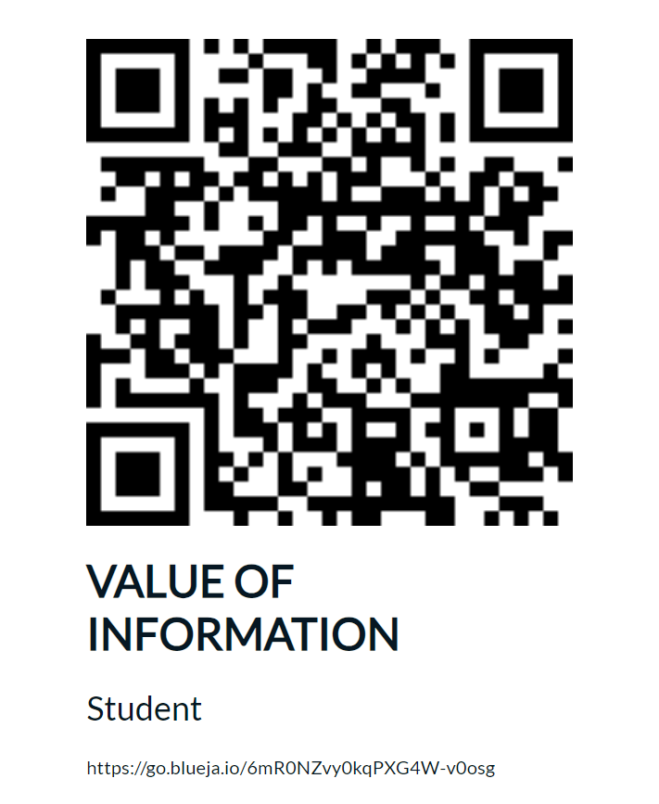
QR code for eVALUate Scan the QR Code to go directly to give feedback on your unit (on-campus)
(cut and paste your unique QR code from your email here)

Slide 43
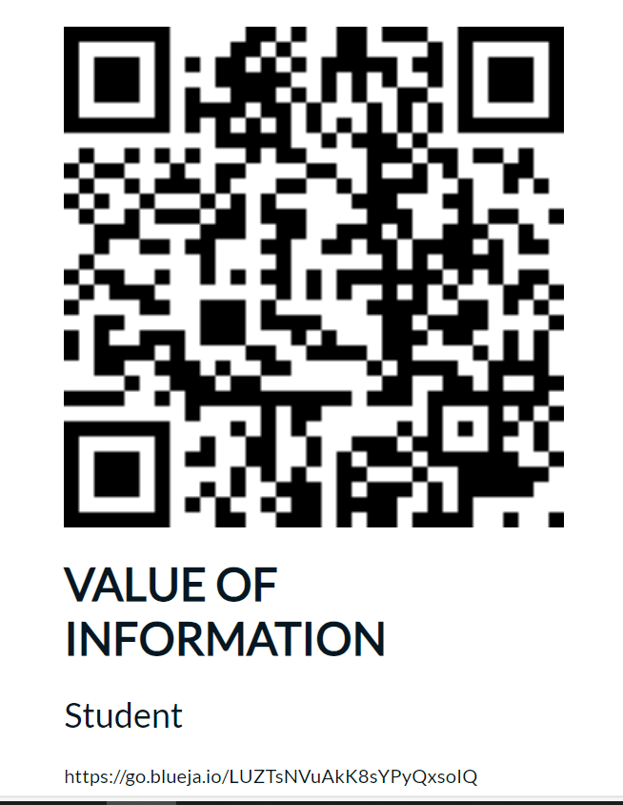
QR code for eVALUate Scan the QR Code to go directly to give feedback on your unit (off-campus/Cloud)
(cut and paste your unique QR code from your email here)

Slide 44
That concludes the MIS782 content
Thank you for being here
Thank you for being a wonderful bunch!!

